Slide 1
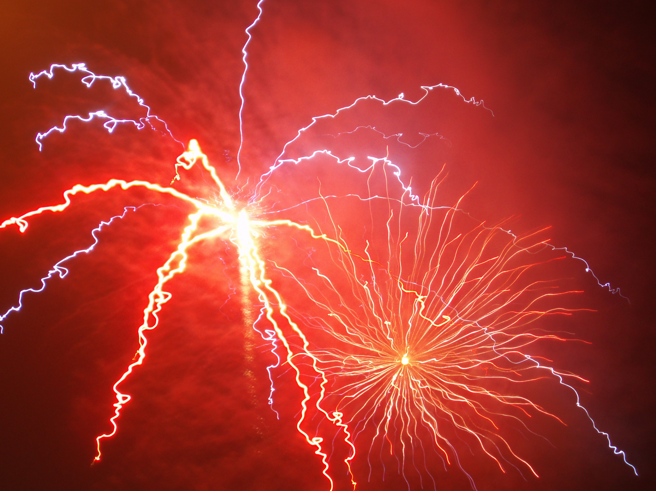
Welcome to my light and sound extravaganza!
Fireworks source: http://www.morguefile.com/archive/display/170731

Slide 2
Our learning in science
In science, we have been learning about light and sound.
In all of our science lessons, we observe with our senses.
We also investigate, share ideas
and record.

Slide 3
We observed objects that produce light and sound.
Insert student photo/s

Slide 4
We learned that light comes from a variety of sources, including the sun.
Insert student photo/s

Slide 5
We observed many different ways that we use light in our world.
Insert student photo/s

Slide 6
We investigated light, including the brightness and colour of light effects.
Insert student photo/s

Slide 7
We observed sounds and how they are helpful in everyday life.
Insert student photo/s

Slide 8
We investigated making and changing sounds with instruments and objects.
Insert student photo/s

Slide 9
We learned about pitch and volume in sound.
Insert student photo/s

Slide 10
We investigated the purpose of light and sound in toys and instruments.
Insert student photo/s

Slide 11
We constructed objects which produce light and/or sound.
Insert student photo/s

Slide 12
We planned and created effects to make a story more exciting.
Insert student photo/s

Slide 13
We are now going to perform the story with our very own light-and-sound effects.
We hope you enjoy the show.
Fireworks source: http://www.morguefile.com/archive/display/170731

