Slide 1
Patterns all around

Slide 2
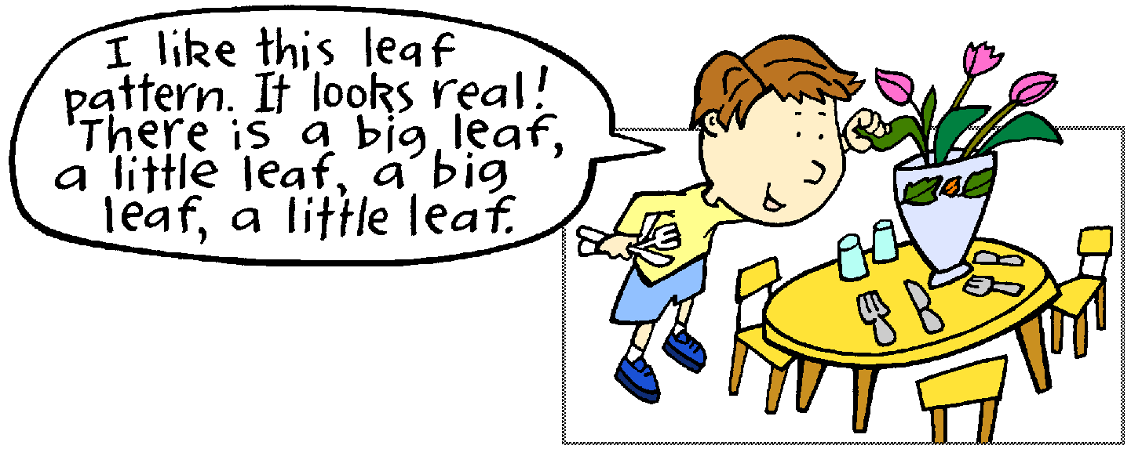
Source: DETE

Slide 3
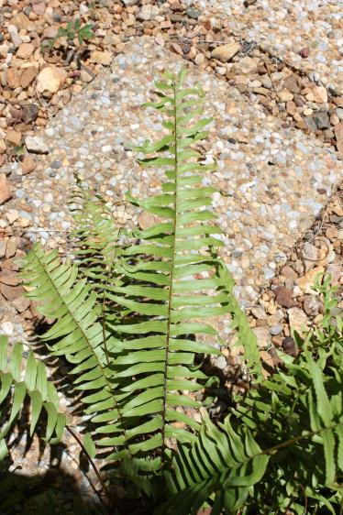
Source: chum1215
Image URI: http://mrg.bz/wUkecN
Source: DETE

Slide 4
Source: DETE

Slide 5
Source: DETE

Slide 6
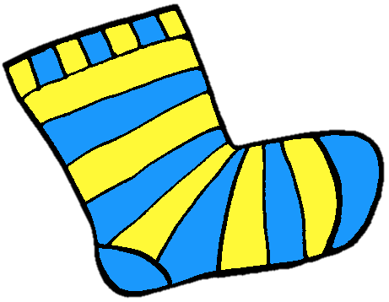
Source: DETE

Slide 9
Record sound pattern with instruments
Source: DETE

Slide 14
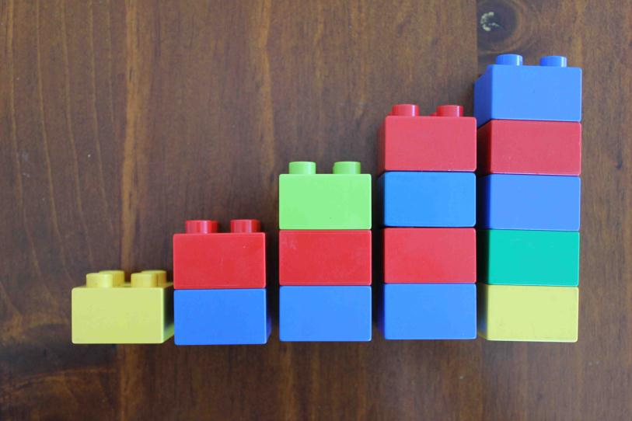
Source: DETE

