Slide 1
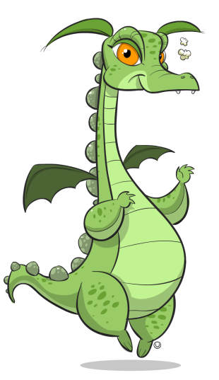

Count to 20!
Click on each picture to count how many.
Click on the ? to see the numeral.
Click on to go to the next page.

Slide 2




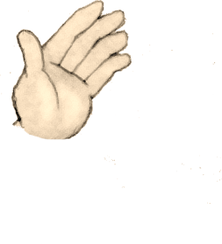


3
?
How many are there

Slide 3


















14
?
How many are there

Slide 4


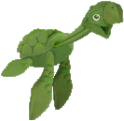


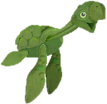


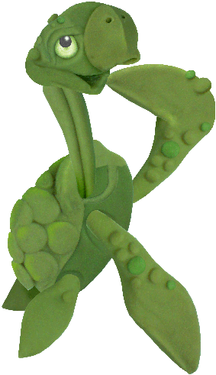
8
?
How many are there

Slide 5
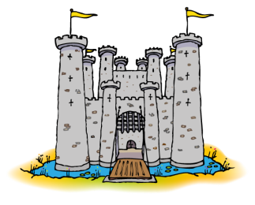


1
?
How many are there

Slide 6





















20
?
How many are there

Slide 7










9
?
How many are there

Slide 8










18
?
How many are there

Slide 9



2
?
How many are there

Slide 10









7
?
How many are there

Slide 11












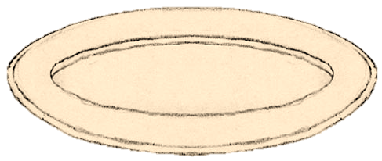




15
?
How many are there

Slide 12



11
?
How many are there

Slide 13












17
?
How many are there

Slide 14
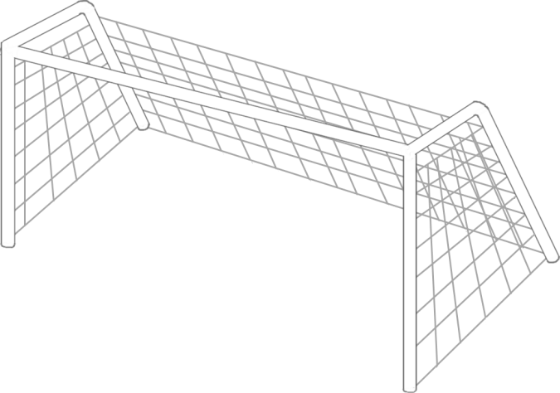


13
?
How many are there

Slide 15






5
?
How many are there

Slide 16


16
?
How many are there

Slide 17













12
?
How many are there

Slide 18




















19
?
How many are there

Slide 19







4
?
How many are there

Slide 20








6
?
How many are there

Slide 21











10
?
How many are there

Slide 22

1
2
3
4
5
6
7
8
9
10
11
12
13
14
15
16
17
18
19
AWESOME!
Have fun counting!
20
Count with me.

